Slide 1


Tech Days: Centric Construct/Fast Forge
Shawn Wallace
July 2021
NOTICE: PROPRIETARY AND CONFIDENTIAL
This material is proprietary to and contains trade secrets and information which is solely the property of Centric Consulting, LLC. It is solely for the Client’s internal use and shall not be used, reproduced, copied, disclosed, transmitted, in whole or in part, without the express consent of Centric Consulting, LLC. © 2019 Centric Consulting, LLC. All rights reserved.

Slide 2

Table of contents
01
Centric Construct/Fast Forge Overview
Fast Forge Architecture
CQRS
Mediator Design Pattern
How to Contribute
Let’s Add Some Features!
02
03
04
05
06
Notes:
Designed Table of Contents if you want to incorporate page numbers and animation.

Slide 3

Centric Construct and Fast Forge

Slide 4


Designed for fast, effective agile work development, delivery, and operations​
We have a process that is repeatable, efficient, and has a predictable level of success built in. That is why we have elected to provide significant tooling to follow an 'opinionated approach' to software delivery.
Meaning that we have selected a way to do things with significant support and tooling provided to make it easy to follow that predictive pattern. The goal is to drastically reduce friction in developing solutions.
IDEATE. INCUBATE. REALIZE. OPERATE
Notes:
Type your notes

Slide 5




Centric Construct’s core competencies are built on modern design and development principles
Experience
Defining what we are building and why to ensure the efficacy with customers
Architecture
Determining the best way to build solutions that start to future proof the tech stack
Experience
Architecture
Development
Building interactions that extract value from information and fulfills strategies for your organization
Development
Notes:
Type your notes

Slide 6






In order to execute with efficiency, flexibility, and quality our Centric Construct utilizes a configurable design and development environment.
Design System
Delivery Platform
Atomic design components leveraged to stitch experiences together. Generated by modern design principles and best practices, this system allows us to complete design rapidly.
Modern development practices build on a specific set of reference architectures used to generate speed and more importantly quality of output.
Notes:
Type your notes

Slide 7

What It Is not
There is much confusion over key phrases in Centric
Not a DevStudio
The Centric Construct is not a replacement of the DevStudio concept. DevStudio’s focus on developing applications using multiple languages by dedicated teams. The CC is an opinionated approach for how we turn clients' ideas into tangible, working software.
Not just a DevOps Platform
While the CC uses DevOps as a part of the delivery platform, the CC is much more than that. It involves a system of work management, pipelines, environments, and modern engineering practices.
Not only Right Site
While the CC will use Right Site principles and practices, it is not the total embodiment of RS. RS governs work beyond the type of work the CC does.

Slide 8

How We Differentiate the Centric Construct
The Centric Construct is a 'how'. A process in which we go from design to development to fully operating digital products and solutions. Both the studio concept and our Right Site are also 'hows', but in different ways. While they are mutually exclusive, they integrate and allow for us to expand how we describe our technology offerings.
Centric Construct
Right Site
Studio Concept
How we design, build, deploy and operate digital products
How we create flexible teaming models for clients
How we collaborate both physically and virtually as a team
Leverages Right Site
Staffs Factory Projects
Included in Ways of Working
Evolves the Studio Concept
Included in Studio Operations
Included in Teaming Decisions
Integrates & Extends Offerings
Provides Flexibility for Delivery
Evolves as We Build Factory
Notes:
Type your notes

Slide 9
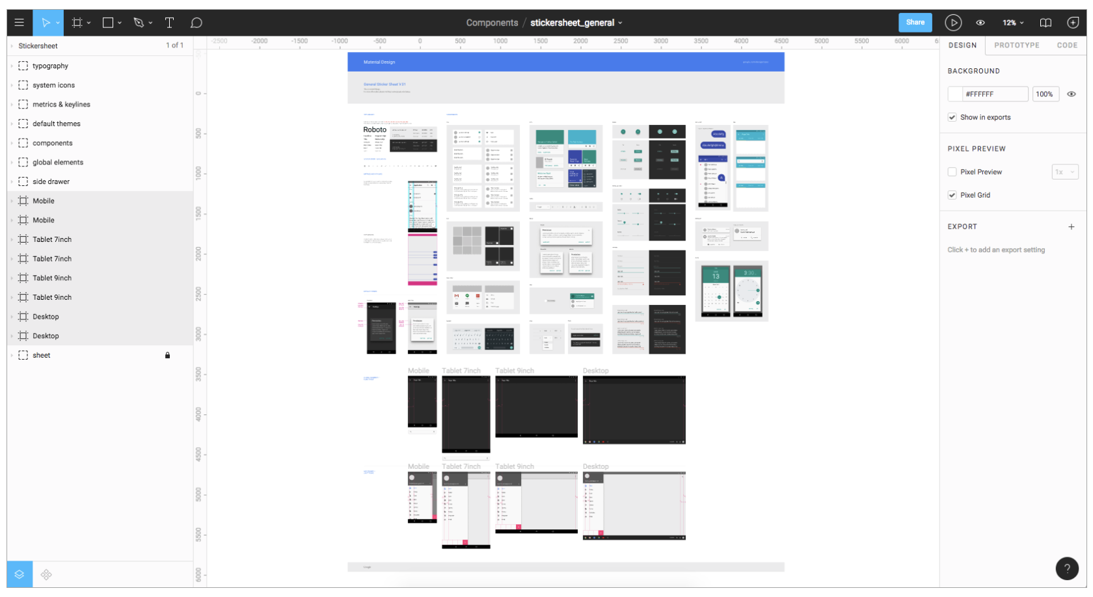
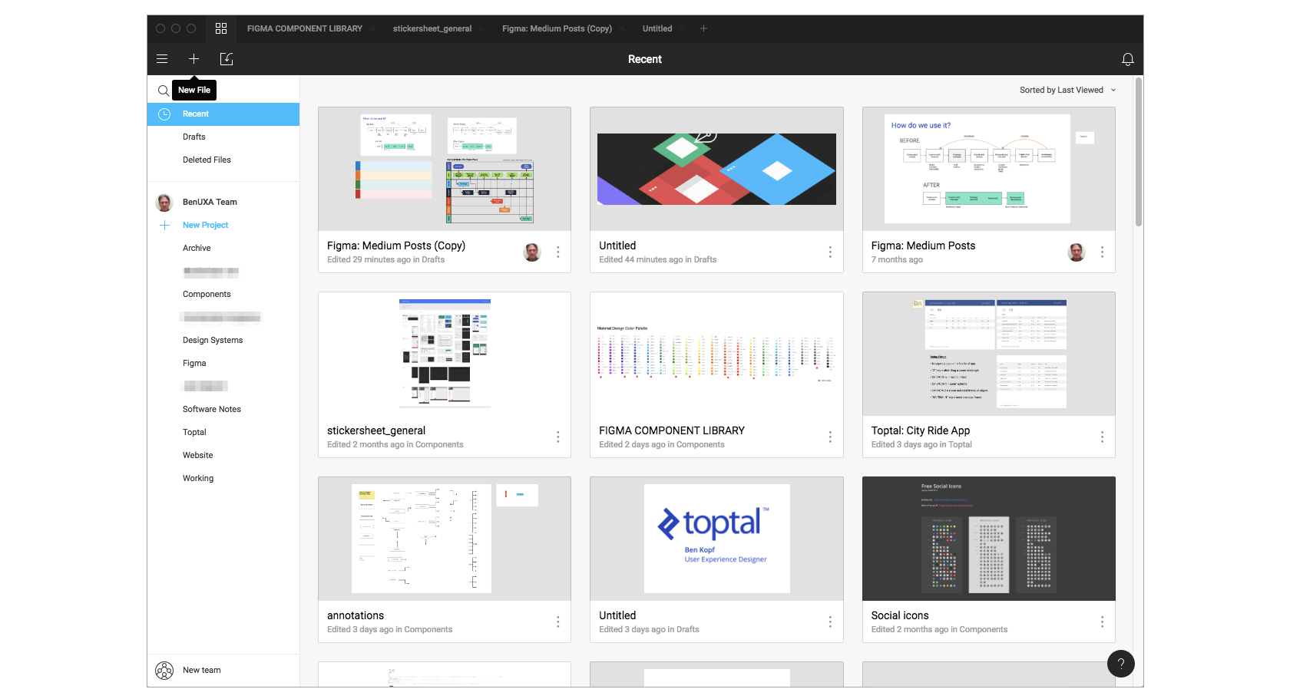
Design Platform
Enables us to build reusable components, easily reskinned, exportable to delivery platform

Slide 10



Delivery Platform
 | Agile Project Management Tooling
 | Reference Application/Architecture
 | Build Pipelines
 | Testing Framework
 | Cloud Environments
 | Deployment Strategies
 | Monitoring Systems
Please write your great title is here
ENABLE DELIVERY IN MINUTES
We’ve built a platform that connects together all of the core components needed in Azure to enable teams/projects to get started with DevOps in a consistent, scalable way incredibly quickly - going from nothing to running infrastructure in minutes, meaning:
Our platform is pre-integrated with right modern tools and the right modern practices to enable our teams to deliver starting day 1.

Slide 11








From empathy to ownership at the right pace for our clients in order to best design and build modern software
3
1
2
Text
Text
Transfer
4
Design
Development
Operate
Notes:
Type your notes

Slide 12





Ensure we give the customer a voice on what the destination is. Empower them to be the advocates
4
1
2
3
Text
Text
Text
Architecture
5
Insights
Ideation
Prototype
Backlog
Notes:
Type your notes

Slide 13





With a focus on continuity, we do not forget about the importance of quality, our framework is constructed to ensure the viability of our products.
1
2
3
4
Text
Text
Text
Systems
Engineering
Testing
Transfer
Devops
Notes:
Type your notes

Slide 14
What do we mean by an Opinionated Approach?

Slide 15
Fast Forge Reference Application Architecture

Slide 16
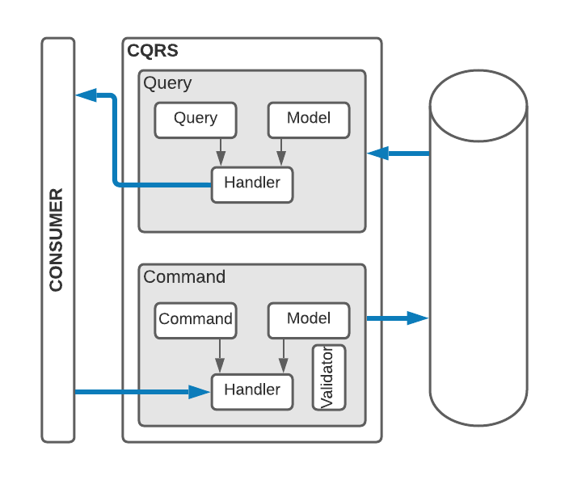
Command-Query Responsibility Segregation
Queries
Consumer creates a Query
Query is sent to a Handler
Handler executes the Query against the database
Handler returns a Model to the Consumer
Commands
Consumer makes a changes to data and creates a Command.
The Command is sent to a Handler.
The Handler executes any Validations and (if valid) updates the database.
The response Model is returned to the Consumer.

Slide 17
Command-Query Responsibility Segregation
Benefits
Single Responsibility
Small classes
Easy to test
Agility
Easy Feature Toggling
Shortcomings
Large number of classes
Discoverability
Maintainability

Slide 18
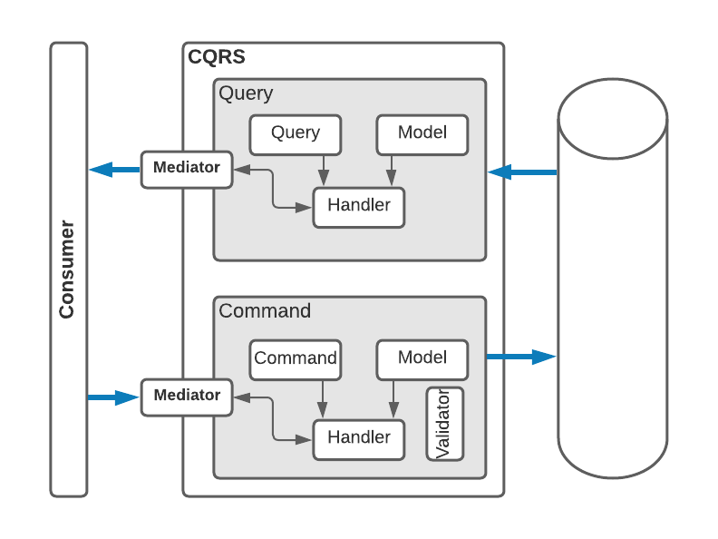
Mediator Design Pattern (full-stack)
Queries
Consumer creates a Query
Query is sent to the Mediator
Mediator determines the Handler
Handler executes the Query against the database
Handler returns a Model to the Mediator which is, in turn, sent to the Consumer
Commands
Consumer makes a changes to data and creates a Command.
The Command is sent to the Mediator.
The Handler executes any Validations and (if valid) updates the database.
The response Model is returned to the Mediator which relays it to the Consumer.
This looks like it has more steps ☹

Slide 19
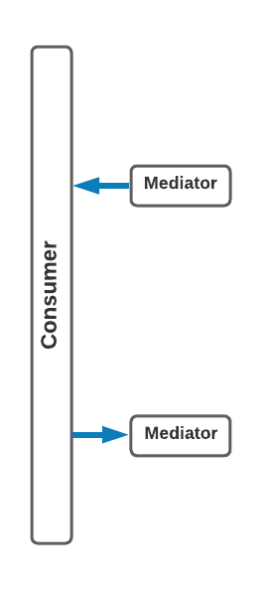
Mediator Design Pattern (from the Consumer)
Queries
Consumer creates a Query
Query is sent to the Mediator
Mediator returns a Model
Commands
Consumer makes a changes to data and creates a Command.
Mediator returns a Model
Query goes in, Model is returned
Command goes in, Model is returned

Slide 20
What Problem does Mediator Solve?
Benefits
Single Responsibility
Small classes
Easy to test
Shortcomings
Large number of classes
Discoverability
Maintainability
Goes from unusable to a great pattern.

Slide 21
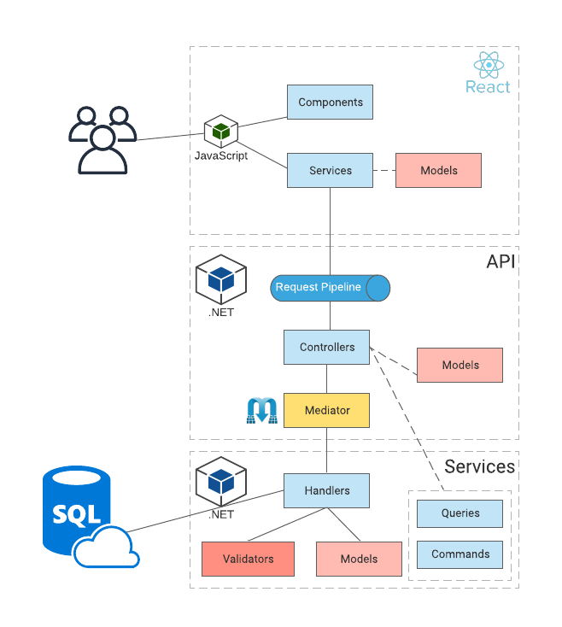
Reference Application Architecture
Tech Stack
ReactJS
.NET Core Web API
MediatR
SqlAzure
Azure Static Site
Azure App Service (Docker)

Slide 22
How Can you Contribute?

Slide 23
Let’s Add a Feature!

Slide 24
Let’s Modify a Feature
Easy first step
As a ToDoer
I want to create a long form comment for a new ToDo
So that I can add more context to my work without making the Title unreadable

Slide 25
Let’s Add a New Feature
A little harder
As a ToDoer
I want to be able to add notes to my ToDo
So that I can take historical while I work on a ToDo
Notes:
A note has a body that is required and can be changed
A note should keep track of when it is created and modified

Slide 26
Template Overview
How to Use this Deck
This deck serves as both a visual guide and a tool to help you streamline and simplify the process of creating presentations.
TIPS:
Avoid sizing copy that’s smaller than 11 pt or larger than 28 pt
Less is more: The clean and spacious layout improves readability and engagement—try to consolidate messaging and keep bullets punchy.
Spread out a busy slide into two separate slides
Use varying type sizes and weights (regular, italic, bold) to create hierarchy within content and help viewers eye read in intended order
Integrating elements and slides from this template will help maintain the integrity of Centric’s brand.
Most slides are modular and can be used by editing the variable content while ensuring the formatting is consistent across all Centric decks
Section Divider slides can be leveraged by replacing the image and changing copy
Important: Please export PowerPoint decks as PDFs when sharing externally
If you are having trouble with anything in this template, you are looking for additional brand elements or you are unsure if your communication best represents the Centric brand, please contact Centric’s design team at lisette.albert@centricconsulting.com

Slide 27

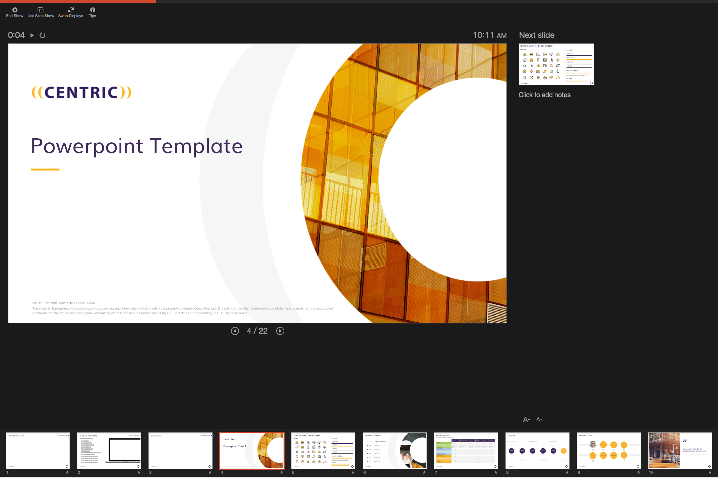
Template Instructions
How to Use this Deck
Quick Links to Video Tutorials (open slide in presentation mode to click links):
How to Install the Centric PowerPoint Template
How to Print Widescreen Format
Using Centric Branded Colors
How to Switch Layouts
How to Access and Use Different Icons or Images
How to Fill a Shape with an Image
How to Resize an Image without Screwing it up
How to Compress your File Size
How to Access our Marketing Materials

Slide 28






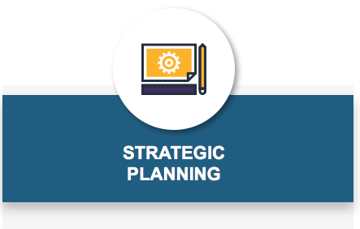
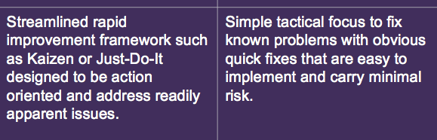
Do’s & Don’ts
How to Use this Deck
Most copy should be the ‘dark grey’ color located in the theme.
Callout words can be treated in either purple or yellow as an accent.
Copy may not be an off-brand color or a screen of purple or yellow.
YES
YES
NO
YES
NO
Use branded icons (Three treatment options: In white circle, alone, or reversed out over yellow circle)
Never use off-brand icons
YES
YES
NO
Images should be bright and include yellow.
Non-people images can have abstract meanings
Never use duotone images.
YES
NO
Reverse copy out of solid color for headers and subheaders
Avoid using reversed copy for paragraphs or body copy

Slide 29

Co-branding Guidelines
How to Use this Deck
Follow these guidelines when using a partner or client logo in a lockup with the Centric logo.
YES
NO
&
Use full-color logos on a white background whenever possible
Ensure both logos are roughly equal in visual weight
Separate the logos by a space equal to the Centric quote marks with a black, ½ pt vertical rule extending a single quote mark above and below the largest ascending and descending elements
Optically align logos to best balance
Don’t alter the divider or add any extraneous design elements
Don’t combine full-color and B&W versions of the logo together
Don’t use low quality or distorted logos

Slide 30
Icons + Colors + Stock Images
ICONS
COLORS
#412C5D
#FCB516
#E7E6E6
#262626
STOCK IMAGES & ICONS
https://centricconsulting.smugmug.com/
Password: centricmarketing123!

Slide 31
Table of contents
0X
Centric Overview
Section 1
Section 2
Section 3
Section 4
Section 5
XX
XX
XX
XX
XX
Notes:
Designed Table of Contents if you want to incorporate page numbers and animation.

Slide 32
Simple table of contents
Title 1
Title 2
Title 3
Notes:
Simple table of contents if you’re looking to create a table of contents quickly.

Slide 33
Proven success
Example teaming arrangements
 | Fidelity | Luxottica / EyeMed | Cardinal Health | AssuraMed | Ascension Health | Nationwide
Background
Company Size | $10B+ | $8.5B | $101B | $1B | $14.3B | $22.4B
Industry | Financial | Vision Care / Insurance | Health Care | Health Care | Health Care | Insurance
Relationship Duration | 2003 to Present | 2007 to Present | 2004 to Present | 2012 to Present | 2009 to Present | 2000 to Present
# of Engagements | 50+ | 35+ | 33+ | 6+ | 10+ | 30+
Business Consulting
Program / Project Management | X | X | X | X | X | X
Business Process Improvement | X | X | X | X |  | X
Business Analysis | X | X | X | X | X | X
Organizational Change Mgmt. | X | X |  |  | X | X
Strategic Planning / Bus Architecture | X |  | X
Technology Consulting
Custom Application Development | X | X | X | X | X | X
BPM | X |  | X | X
Mobile |  | X |  | X
Data & Analytics | X | X |  |  | X | X
IT Strategy | X |  |  | X
Portal / E-Commerce |  | X |  | X
Notes:
Include slide when outlining engagement types, you can use it in conjunction with slide 20

Slide 34
Timeline
Copy can go here
Copy can go here
Copy can go here
1999
2001
2010
2016
2017
2019
Copy can go here
Copy can go here
Copy can go here

Slide 35

Meet our team
Fill with image
Fill with image
Fill with image
Name
Name
Name
Name
Title
Title
Title
Title
Fill with image
Fill with image
Fill with image
Fill with image
Name
Name
Name
Name
Title
Title
Title
Title
Notes:
If the headshot image gets distorted when you fill the yellow circle background, go to Picture Format → click the down carrot next to Crop → Click Fit → resize image to fit the circle while holding Shift.

Slide 36

You can include an inspirational quote too.
- National Marketing, Centric Consulting
Notes:
Quote

Slide 37
Agenda Slide
Introduction
Lauren - 1:00 – 1:20
Topic 2
Jacob – 1:20 – 2:00
Topic 3
Sarah – 2:00 – 3:00

Slide 38
Stats side
79%
77%
64%
32%
Cool statistic goes here
Cool statistic goes here
Cool statistic goes here
Cool statistic goes here

Slide 39

Change background image.
Company name Case Study Title
Fill with screenshot
Fill with screenshot
1-2 sentence description

Slide 40

Case Study Title
FORTUNE 500
Healthcare Services logo
1- 2 sentence description of case study
Results
Tangible results 1
Tangible results 2
Tangible results 3

Slide 41
Header statement
Key message
Option 1
Bus estem fugiassin res es exceatiatin pe vit, con nonecepro occumqui doluptatia volupit, qui to eum quidenit, exceptatem doluptate molore accus quisimolo ipset conet, solecti onsenis.
Option 2
Bus estem fugiassin res es exceatiatin pe vit, con nonecepro occumqui doluptatia volupit, qui to eum quidenit, exceptatem doluptate molore accus quisimolo ipset conet, solecti onsenis.
Option 3
Bus estem fugiassin res es exceatiatin pe vit, con nonecepro occumqui doluptatia volupit, qui to eum quidenit, exceptatem doluptate molore accus quisimolo ipset conet, solecti onsenis.
Option 4
Bus estem fugiassin res es exceatiatin pe vit, con nonecepro occumqui doluptatia volupit, qui to eum quidenit, exceptatem doluptate molore accus quisimolo ipset conet, solecti onsenis.

Slide 43

3 Key Takeaways
1
Takeaway 1
2
Takeaway 2
3
Takeaway 3
Takeaway 4
BONUS

Slide 44


Value slide
Decreased
User frustration
Development time
Hardware & storage costs
Business Continuity & Disaster Recovery costs
Enterprise computing costs
Monitoring & backup costs
Training & support costs
Maintenance costs
Software licensing costs
Speed and agility
Pace of innovation
Ability to match spend to business need
Accessibility
Scalability
Availability
Flexibility
Security
Enforceability
Portability
Reliability
Increased
Notes:
Checkpoint to crowd – who is doing what?

Slide 45

4 options or a grid
YOUR TITLE
YOUR TITLE
Far far away, behind the word mountains, far from the countries Vokalia and Consonantia, there live the blind texts.
Far far away, behind the word mountains, far from the countries Vokalia and Consonantia, there live the blind texts.
Far far away, behind the word montains, far from the countries Vokalia and Consonantia, there live the blind texts.
YOUR TITLE
YOUR TITLE
Far far away, behind the word mountains, far from the countries Vokalia and Consonantia, there live the blind texts.
Far far away, behind the word mountains, far from the countries Vokalia and Consonantia, there live the blind texts.

Slide 46
Title
Bullet
Bullet
Bullet

Slide 47

Example statement: IoT Market will grow to almost $500B by 2020; connecting nearly 30 Billion devices.
Forbes 2017
Notes:
Potential Stat: “20 Billion connected devices by 2020”?

Slide 48

Definition of service
Short paragraph about service
20%
STAT COPY CAN GO HERE BY THE YEAR
50%
INCREASE IN STAT COPY INSERTED HERE
2020
OF ENTERPRISES WILL RUN ON CONTAINERIZED APPS

Slide 49

Title for Obstacles / Journey Mapping
Hidden
Costs
IT
Org Change
Partners
Sales
Regulatory
& Security
Over-hyped
Expectations
Industry
Disruptors
49
Notes:
True innovation has seen missteps from organizations because it is complex and requires moving the organization into new places and avoiding obstacles. Want to review three stories on how we have been able to do this

Slide 50
First Name Last Name
TITLE
Email@emailgoeshere.com
Short bio goes here.
Fill this shape with team member image
CLIENT EXPERIENCE:
EXPERT IN:
Bullet 1
Bullet 2
Bullet 3
Bullet 1
Bullet 2
Bullet 3
22

Slide 51

4 Step Approach
Key message
STEP 1
Bullet 1
Bullet 2
Bullet 3
STEP 3
Bullet 1
Bullet 2
Bullet 3
Bullet 1
Bullet 2
Bullet 3
Bullet 1
Bullet 2
Bullet 3
STEP 2
STEP 4
51

Slide 52

Contact Us
First-name Last-name
Title Placeholder
123 - 456 – 7890
email@centricconsulting.com
www.centricconsulting.com
Notes:
- The next steps section will be your wrap up and thank you slides. We are going to add a slide for you to be able to list what’s next before we move to the contact us slide, so that will be available when we distribute the deck to all of Centric.

